Slide 1
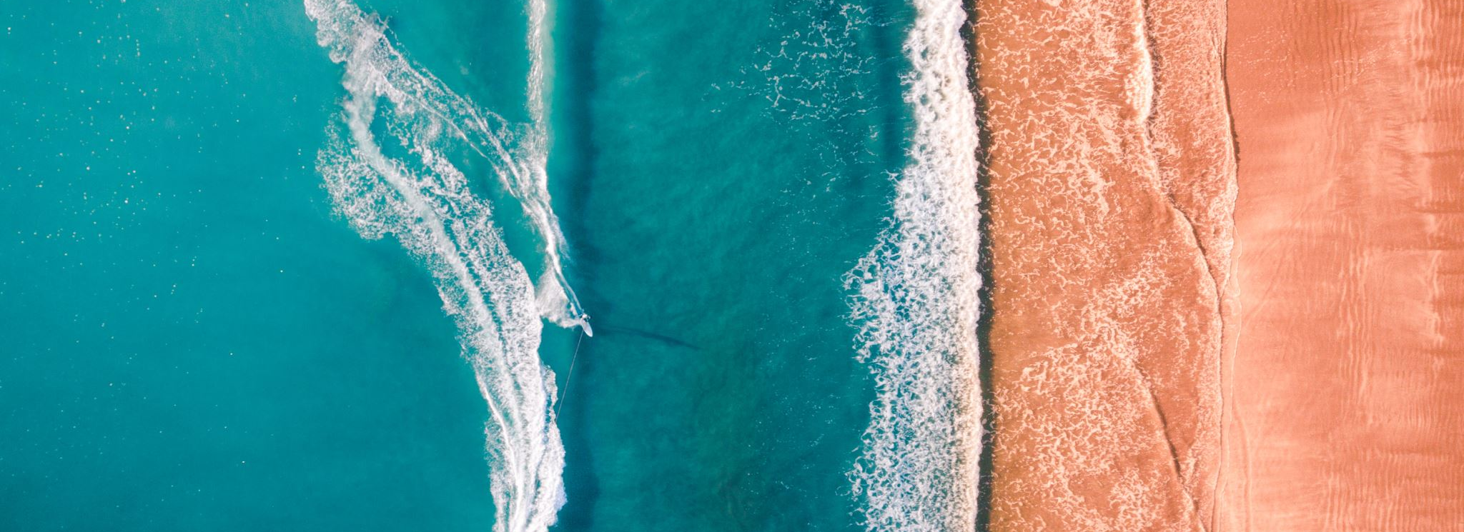
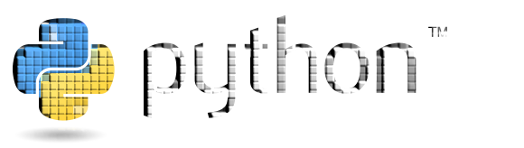
Python – Library (Built-in Modules)

Slide 2
Highlights!
pygame introduction
pygame surface
pygame time()
pygame drawing
pygame events
pygame advance

Slide 3
Library in Python
A collection of code scripts or modules that can be used iteratively and are linked together to save time is known as a library.
It has code bundles that can be used again and again in different programs. Since then, we will not need to compose the same code for various projects.
Python libraries are heavily used in a variety of fields, including data visualization, machine learning, game development, and computer science.
It has built-in modules that allow the user to access I/O and a few other essential modules as well as fundamental functions.
The Python standard library has more than 200 core modules and are written in C language.
For example: pygame, scipy, matplotlib, numpy, pandas, etc.

Slide 4
pygame
Cross-platform set of Python modules to create video games.
Computer graphics and sound libraries designed to be used with the Python programming language.
Written by Pete Shinners to replace PySDL.
Pygame is suitable to create client-side applications that can be potentially wrapped in a standalone executable.

Slide 5
pygame preparation
Install:
Using “pip” tool (which is what python uses to install packages). The command
is the following:
py -m pip install -U pygame --user
Using IDE
Import:
import pygame

Slide 6
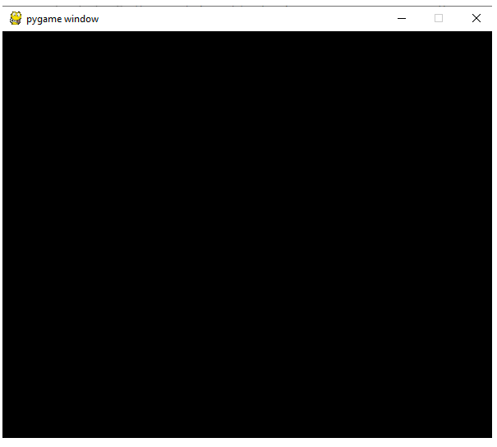
A simple pygame example: Surface
import pygame
pygame.init()
surface = pygame.display.set_mode((400,500))
done = False
while not done:
for event in pygame.event.get():
if event.type == pygame.QUIT:
done = True
pygame.display.flip()
………………………………………………………………..
x, y = surface.get_size()
print(x, y)
surface = pygame.display.set_mode((400, 500), pygame.RESIZABLE)

Slide 7
Let's understand the basic syntax of the above program line by line:
import pygame - access to the pygame framework and imports
all functions of pygame.
pygame.init ( ) - This is used to initialize all the required module of the pygame.
pygame.display.set_mode ((width, height)) - This is used to display a window of
the desired size. The return value is a Surface object which is the object where
we will perform graphical operations.
pygame.event.get ( )- This is used to empty the event queue. If we do not call this,
the window messages will start to pile up and, the game will become unresponsive
in the opinion of the operating system.
pygame.QUIT - This is used to terminate the event when we click on the close button
at the corner of the window.
pygame.display.flip ( ) - Pygame is double-buffered, so this shifts the buffers. It is
essential to call this function to make any updates that you make on the
game screen to make visible.

Slide 8
More on Surface
# Initializing RGB Color
color = (255, 0, 0)
# Changing surface color
surface.fill(color)
pygame.display.flip()
# Set caption
pygame.display.set_caption(‘Hello’)
# Take image as input
img = pygame.image.load('gfg_image.jpg')
# Set image as icon
pygame.display.set_icon(img)
# putting our image on surface on
surface.blit(img,(0,0))
# creating a copy of sample_surface and naming it
copied_surface=pygame.Surface.copy(surface)
# putting our image surface on display surface
# making the alpha value of surface as 100
pygame.Surface.set_alpha(image, 100)
# if color is red do change it to green
# and vice-versa
if(color == "red"):
color = "green"
else:
color = "red"

Slide 9
pygame time()
pygame.time.wait: pause the running of the program for a duration
pygame.time.get_ticks: a time which has been running in milliseconds
pygame.time.delay: same as pygame.time.wait function the difference is that this function will use the processor (rather than sleeping) to make the delay more accurate.
pygame.time.Clock: create a clock object which can be used to keep track of time

Slide 10
1. import pygame
2.
3. pygame.init()
4.
5. i=0
6. while i<5:
7.
8. # storing the time in ticks variable
9. ticks = pygame.time.get_ticks()
10.
11. # printing the variable ticks
12. print(ticks)
13.
14. # increasing the value of i by 1
15. i = i+1
16.
17. # pausing the script for 1 second
18. pygame.time.wait(1000)

Slide 11
pygame drawing
pygame.draw.polygon(surface, color, pointlist, thickness)
thickness of line parameter is optional.
pygame.draw.line(surface, color, start point, end point, thickness)
pygame.draw.circle(surface, color, center point, radius, thickness)
pygame.draw.rect(surface, color, rectangle tuple, thickness)

Slide 12
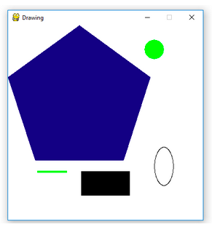
pygame drawing
1. import pygame
2. pygame.init()
3.
4. white = (255, 255, 255)
5. green = (0, 255, 0)
6. blue = (0, 0, 128)
7. black = (0, 0, 0)
8. red = (255, 0, 0)
9.
10. display_surface = pygame.display.set_mode((400, 400 ))
11. pygame.display.set_caption('Drawing’)
12. display_surface.fill(white)
13.
14. pygame.draw.polygon(display_surface, blue, [(146, 0), (291, 106), (236, 277), (56, 277), (0, 106)])
15. pygame.draw.line(display_surface, green, (60, 300), (120, 300), 4)
16. pygame.draw.circle(display_surface, green, (300, 50), 20, 0)
17. pygame.draw.ellipse(display_surface, black, (300, 250, 40, 80), 1)
18. pygame.draw.rect(display_surface, black, (150, 300, 100, 50))
19.
20. while True :
21. for event in pygame.event.get() :
22. if event.type == pygame.QUIT :
23. pygame.quit()
24. quit()
25. pygame.display.update()

Slide 13
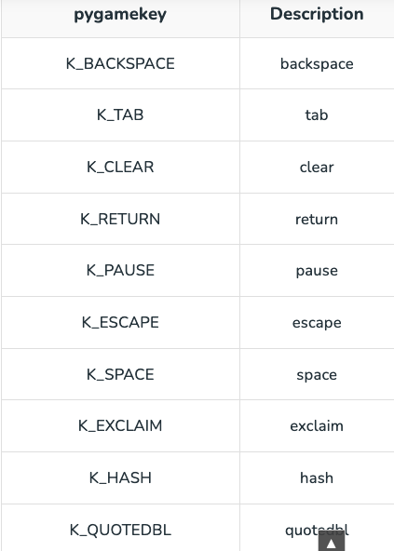
pygame events
1. import pygame
2.
3. import sys
4.
5. pygame.init()
6.
7. display = pygame.display.set_mode((300, 300))
8.
9. while True:
10.
11. for event in pygame.event.get():
12. if event.type == pygame.QUIT:
13. pygame.quit()
14. sys.exit()
15.
16. # checking if keydown event happened or not
17. if event.type == pygame.KEYDOWN:
18.
19. # if keydown event happened
20. # than printing a string to output
21. print("A key has been pressed")

Slide 14
pygame custom events
Although pygame comes with a set of events (Eg: KEYDOWN and KEYUP), it allows
us to create our own additional custom events according to the requirements of
our game.
# Here ADDITION and SUBTRACTION is the event name
ADDITION = pygame.USEREVENT + 1
SUBTRACTION = pygame.USEREVENT + 2
Publishing our custom events can be done in two ways:
pygame.event.post() method.
pygame.time.set_timer() method.

Slide 15
Using pygame.event.post() method
# Step 1 – Convert event into event datatype of pygame
ADD_event = pygame.event.Event(event)
# Step 2 – Post the event
pygame.event.post(ADD_event)
Using pygame.event.timer() method
# event_name, time in ms
pygame.time.set_timer(event, duration)

Slide 16
1. import pygame
2. pygame.init()
3.
4. screen = pygame.display.set_mode((500, 500))
5. timer = pygame.time.Clock()
6.
7. pygame.display.set_caption('Custom Events’)
8.
9. WHITE = (255, 255, 255)
10. RED = (255, 0, 0)
11. GREEN = (0, 255, 0)
12. BLUE = (0, 0, 255)
13.
14. bg_active_color = WHITE
15. screen.fill(WHITE)
16.
17. # custom user event to change color
18. CHANGE_COLOR = pygame.USEREVENT + 1
19.
20. # custom user event to inflate defalte box
21. ON_BOX = pygame.USEREVENT + 2
22.
23. box = pygame.Rect((225, 225, 50, 50))
24. grow = True
25.
26. # posting a event to switch color after every 500ms
27. pygame.time.set_timer(CHANGE_COLOR, 500)
28. running = True
29. while running:
30.
31. for event in pygame.event.get():
32.
33. if event.type == CHANGE_COLOR:
34. if bg_active_color == GREEN:
35. screen.fill(GREEN)
36. bg_active_color = WHITE
37. elif bg_active_color == WHITE:
38. screen.fill(WHITE)
39. bg_active_color = GREEN
40.
41. if event.type == ON_BOX:
42.
43. # to inflate and deflate box
44. if grow:
45. box.inflate_ip(3, 3)
46. grow = box.width < 75
47. else:
48. box.inflate_ip(-3, -3)
49. grow = box.width < 50
50.
51. if event.type == pygame.QUIT:
52. running = False

Slide 17
53. # Posting event when the cursor is on top of the box
54. if box.collidepoint(pygame.mouse.get_pos()):
55. pygame.event.post(pygame.event.Event(ON_BOX))
56.
57. # Drawing rectangle on the screen
58. pygame.draw.rect(screen, RED, box)
59.
60. # Updating Screen
61. pygame.display.update()
62.
63. # Setting Frames per Second
64. timer.tick(30)
65.
66. pygame.quit()

Slide 18
Display text to pygame window
1. import pygame
2. pygame.init()
3.
4. white = (255, 255, 255)
5. green = (0, 255, 0)
6. blue = (0, 0, 128)
7.
8. display_surface = pygame.display.set_mode((400, 400))
9. pygame.display.set_caption('Show Text’)
10.
11. # create a font object
12. # 1st parameter is the font file
13. # which is included in pygame
14. # 2nd parameter is size of the font
15. font = pygame.font.Font('freesansbold.ttf', 32)
16.
17. # create a text surface object on which text is drawn on it
18. text = font.render(‘Python for Game Dev', True, green, blue)
19.
20. # create a rectangular object for the text surface object
21. textRect = text.get_rect()
22.
23. # set the center of the rectangular object
24. textRect.center = (X // 2, Y // 2)
25. # infinite loop
26. while True:
27.
28. display_surface.fill(white)
29.
30. # copying the text surface object
31. # to the display surface object
32. # at the center coordinate.
33. display_surface.blit(text, textRect)
34.
35. # iterate over the list of Event objects
36. # that was returned by pygame.event.get() method
37. for event in pygame.event.get():
38.
39. if event.type == pygame.QUIT:
40.
41. # deactivates the pygame library
42. pygame.quit()
43.
44. # quit the program
45. quit()
46.
47. # Draws the surface object to the screen
48. pygame.display.update()

Slide 19
Moving an Image with mouse
1. import pygame
2. from pygame.locals import *
3.
4. YELLOW = (255, 255, 0)
5. BLUE = (0, 0, 255)
6.
7. pygame.init()
8.
9. screen = pygame.display.set_mode((640, 350))
10.
11. img = pygame.image.load('geek.jpg’)
12. img.convert()
13.
14. # Draw rectangle around the image
15. rect = img.get_rect()
16. rect.center = w//2, h//2
17.
18. # Set running and moving values
19. running = True
20. moving = False
21.
22. # Setting what happens when game
23. # is in running state
24. while running:
25.
26. for event in pygame.event.get():
27. if event.type == QUIT:
28. running = False
29.
30. # Making the image move
31. elif event.type == MOUSEBUTTONDOWN:
32. if rect.collidepoint(event.pos):
33. moving = True
34.
35. # Set moving as False if you want to move the image #only with the mouse click. Set moving as True if you #want to move the image without the mouse click
38. elif event.type == MOUSEBUTTONUP:
39. moving = False
40.
41. # Make your image move continuously
42. elif event.type == MOUSEMOTION and moving:
43. rect.move_ip(event.rel)
44.
45. screen.fill(YELLOW)
46. screen.blit(img, rect
47.
48. # Construct the border to the image
49. pygame.draw.rect(screen, BLUE, rect, 2)
50.
51. pygame.display.update()
52.
53. pygame.quit()
36
37

Slide 20
pygame advance (creating interactive button)
1 # open a window
2 screen = pygame.display.set_mode(720,720)
3
4 # white color
5 color = (255,255,255)
6
7 # light shade of the button
8 color_light = (170,170,170)
9
10 # dark shade of the button
11 color_dark = (100,100,100)
12
13 # stores the width of the screen
14 width = screen.get_width()
15
16 # stores the height of the screen
17 height = screen.get_height()
18
19 # defining a font
20 smallfont = pygame.font.SysFont('Corbel',35)
21
22 # rendering a text written in this font
23 text = smallfont.render('quit' , True , color)
24 while True:
25 for ev in pygame.event.get():
26 if ev.type == pygame.QUIT:
27 pygame.quit()
28 #checks if a mouse is clicked
29 if ev.type == pygame.MOUSEBUTTONDOWN:
30
31 #if the mouse is clicked on the button the game is terminated
32 if width/2 <= mouse[0] <= width/2+140 and height/2 <= mouse[1] <= height/2+40:
33 pygame.quit()
34
35 screen.fill((60,25,60))
36
37 # stores the (x,y) coordinates into the variable as a tuple
38 mouse = pygame.mouse.get_pos()
39
40 # if mouse is hovered on a button it changes to lighter shade
41 if width/2 <= mouse[0] <= width/2+140 and height/2 <= mouse[1] <= height/2+40:
42 pygame.draw.rect(screen,color_light,[width/2,height/2,140,40])
43
44 else:
45 pygame.draw.rect(screen,color_dark,[width/2,height/2,140,40])
46
47 # superimposing the text onto our button
48 screen.blit(text , (width/2+50,height/2))
49 # updates the frames of the game
50 pygame.display.update()

Slide 21
Moving an object in pygame
1 # object current co-ordinates
2. x = 200
3. y = 200
4 # dimensions of the object
5. width = 20
6. height = 20
7. # velocity / speed of movement
8. vel = 10
9. # Indicates pygame is running
10. run = True
11. while run:
12 # creates time delay of 10ms
13 pygame.time.delay(10)
14
15 # iterate over the list of Event objects
16 # that was returned by pygame.event.get() method
17 for event in pygame.event.get():
18
19 # if event object type is QUIT
20 # then quitting the pygame
21 # and program both
22 if event.type == pygame.QUIT:
23
24 # it will make exit the while loop
25 run = False
26 # stores keys pressed
27 keys = pygame.key.get_pressed()
28. # if left arrow key is pressed
29 if keys[pygame.K_LEFT] and x>0:
30 # decrement in x co-ordinate
31 x -= vel
32 # if left arrow key is pressed
33 if keys[pygame.K_RIGHT] and x<500-width:
34 # increment in x co-ordinate
35 x += vel
36 # if left arrow key is pressed
37 if keys[pygame.K_UP] and y>0:
38 # decrement in y co-ordinate
39 y -= vel
40 # if left arrow key is pressed
41 if keys[pygame.K_DOWN] and y<500-height:
42 # increment in y co-ordinate
43 y += vel
44 win.fill((0, 0, 0))
45
46 # drawing object on screen which is rectangle here
47 pygame.draw.rect(win, (255, 0, 0), (x, y, width, height))
48
49 # it refreshes the window
50 pygame.display.update()
51
52 # closes the pygame window
53. pygame.quit()

Slide 22
Playing audio file in Pygame
1. from pygame import mixer
2
3. # Starting the mixer
4. mixer.init()
5
6. # Loading the song
7. mixer.music.load("song.mp3")
8
9. # Setting the volume
10. mixer.music.set_volume(0.7)
11
12. # Start playing the song
13 mixer.music.play()
14
15. # infinite loop
16 while True:
17
18 print("Press 'p' to pause, 'r' to resume")
19 print("Press 'e' to exit the program")
20 query = input(" ")
21
22 if query == 'p’:
23
24 # Pausing the music
25 mixer.music.pause()
26 elif query == 'r':
27 # Resuming the music
28 mixer.music.unpause()
29 elif query == 'e’:
30
31 # Stop the mixer
32 mixer.music.stop()
33 break

